Slide 1

Python Fundamentals (week 4)
Louis Rey
UCSD Extension

Slide 2
Week 4 Objectives
Regular Expressions
Multithreading and Multiprocessing
Network and Client/Server Programming
Pickling

Slide 3
Regular Expressions

Slide 4
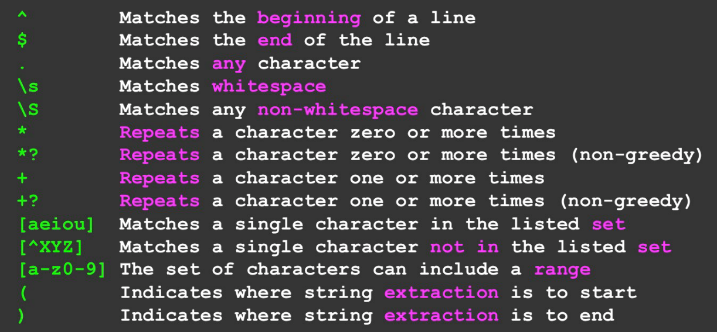
Common Regular Expressions

Slide 5
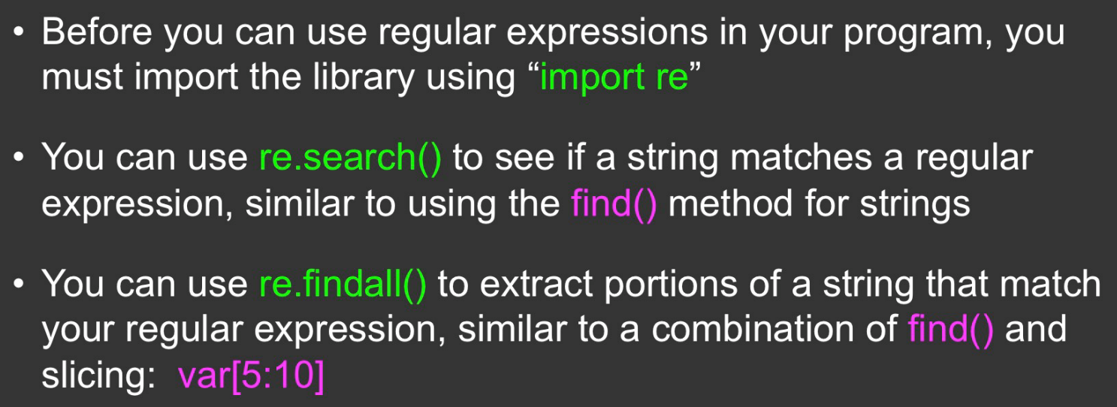

Slide 6
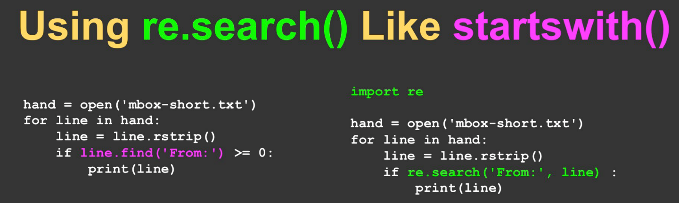

Slide 7
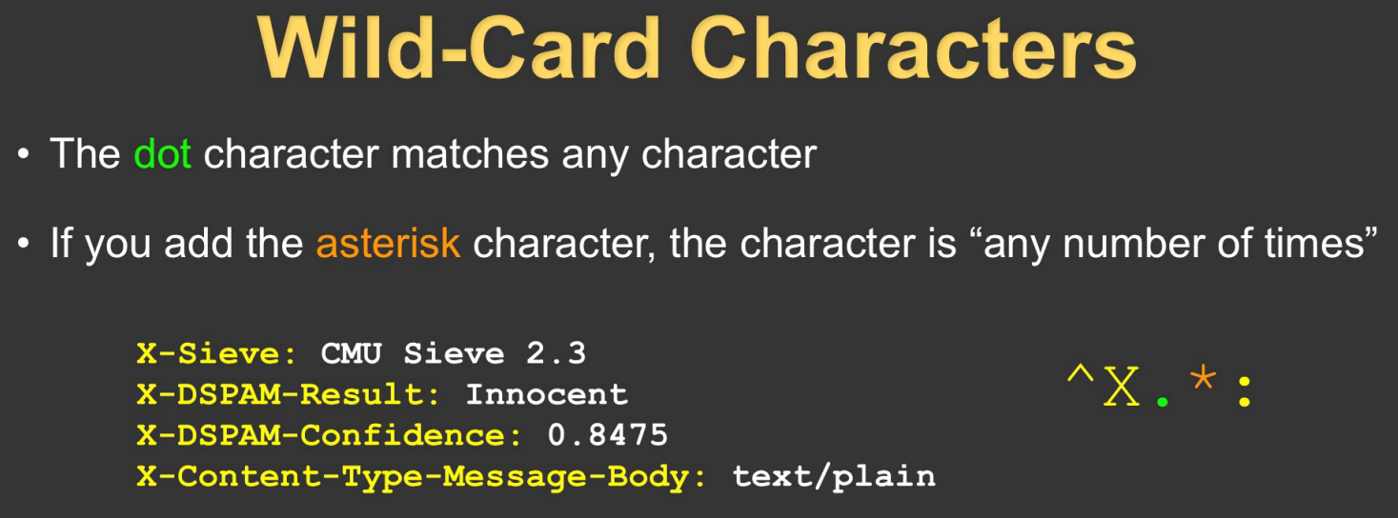
The asterisk actually represents zero or more

Slide 8
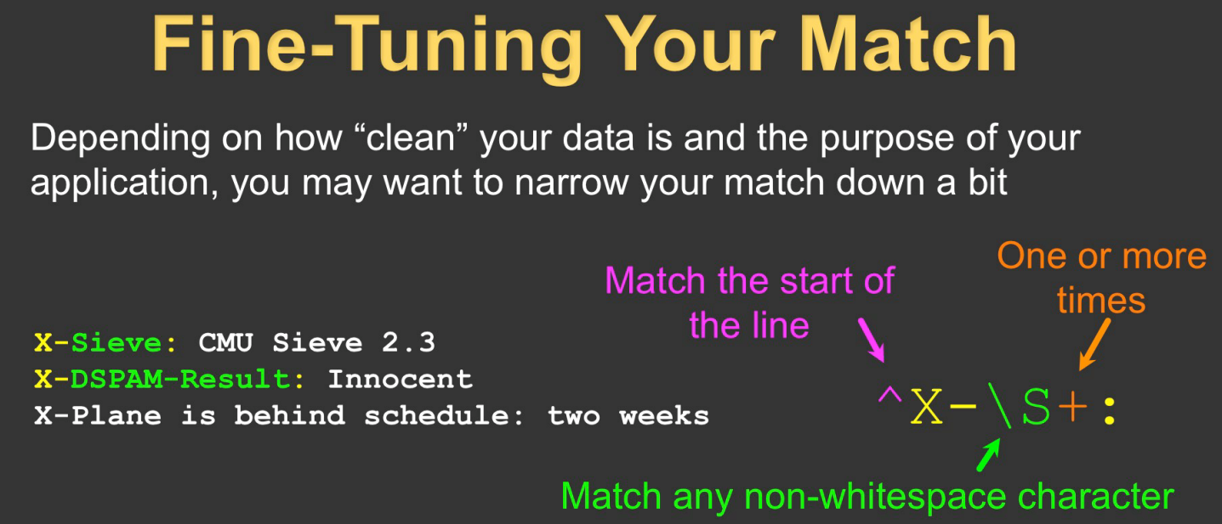
The plus symbol actually represents one or more

Slide 9
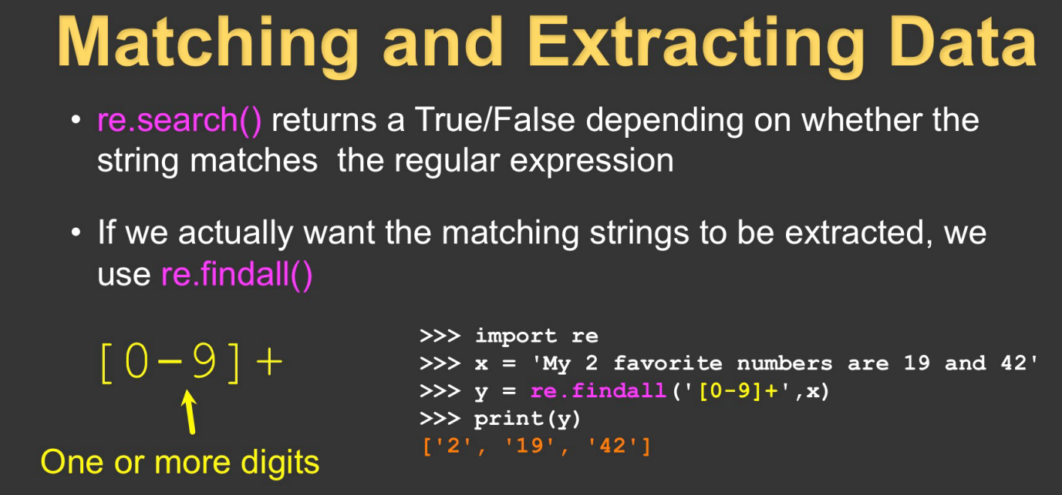
Use [0 – 9.] for numbers with decimal points

Slide 10
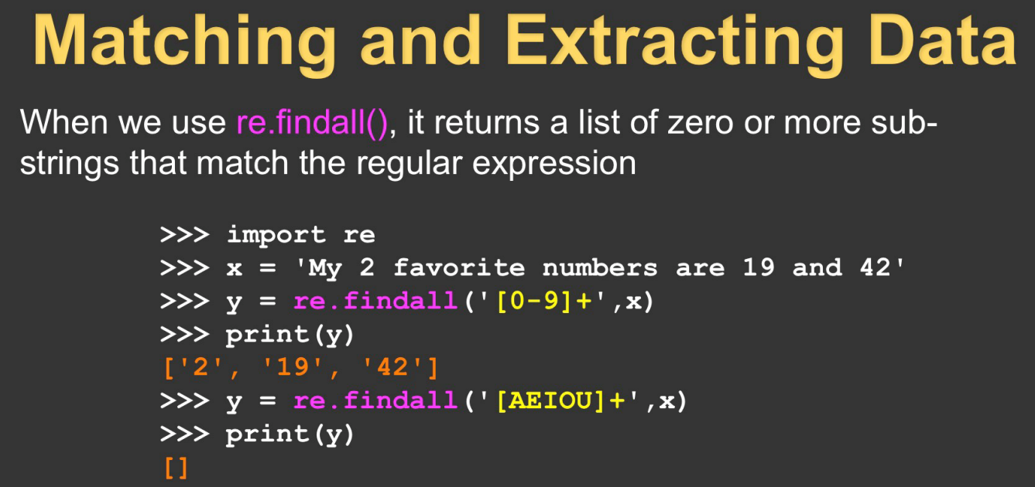

Slide 11
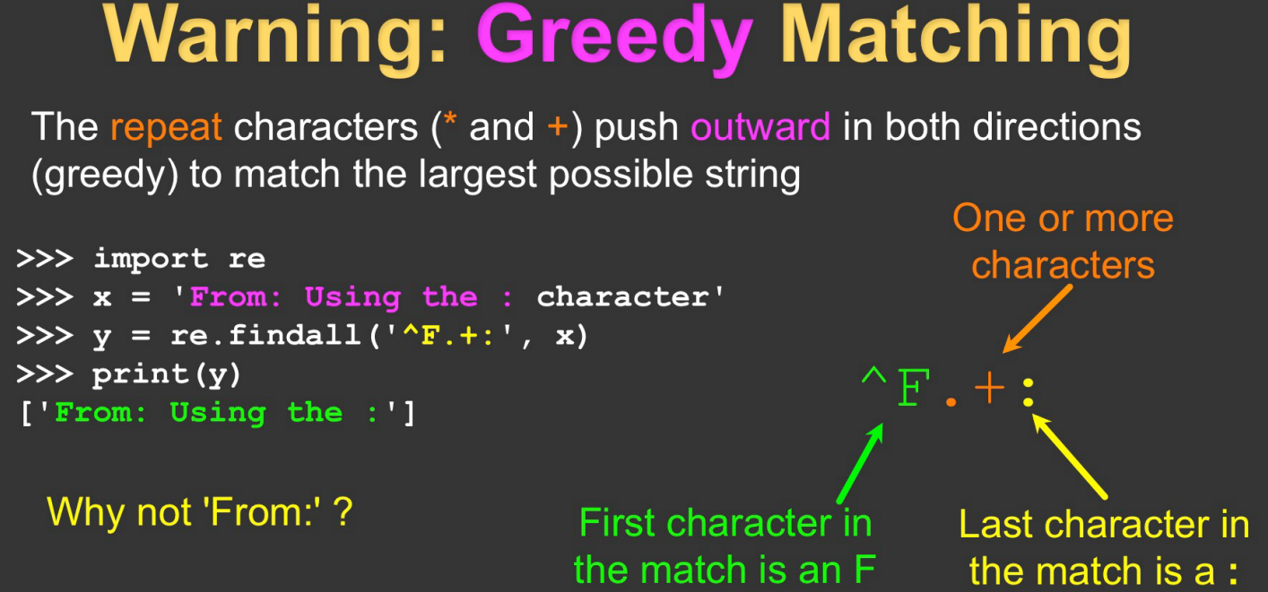

Slide 12
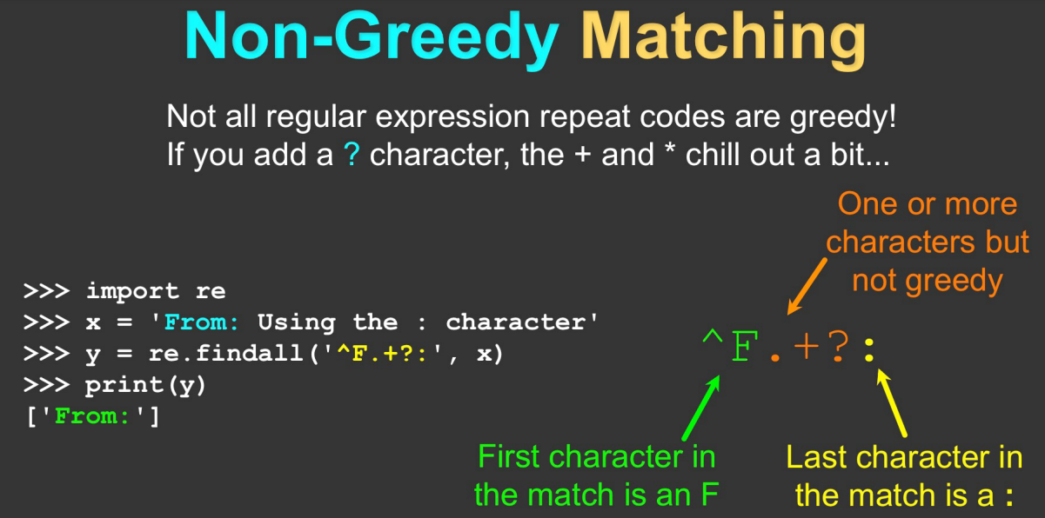

Slide 13
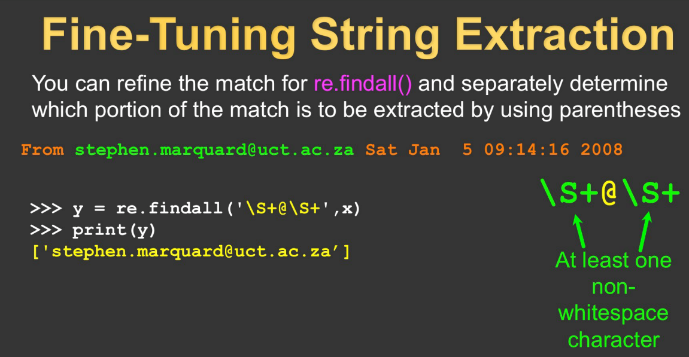

Slide 14
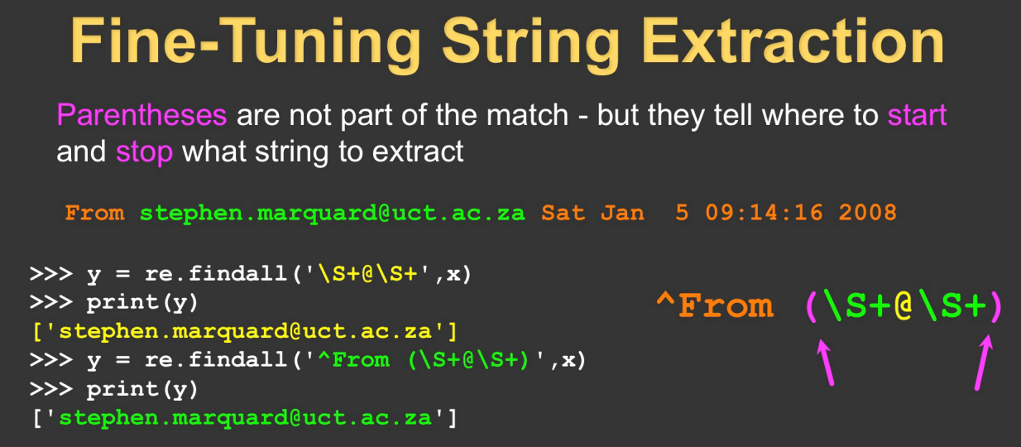
An exact match is requested but only the content in the parenthesis is returned.

Slide 15
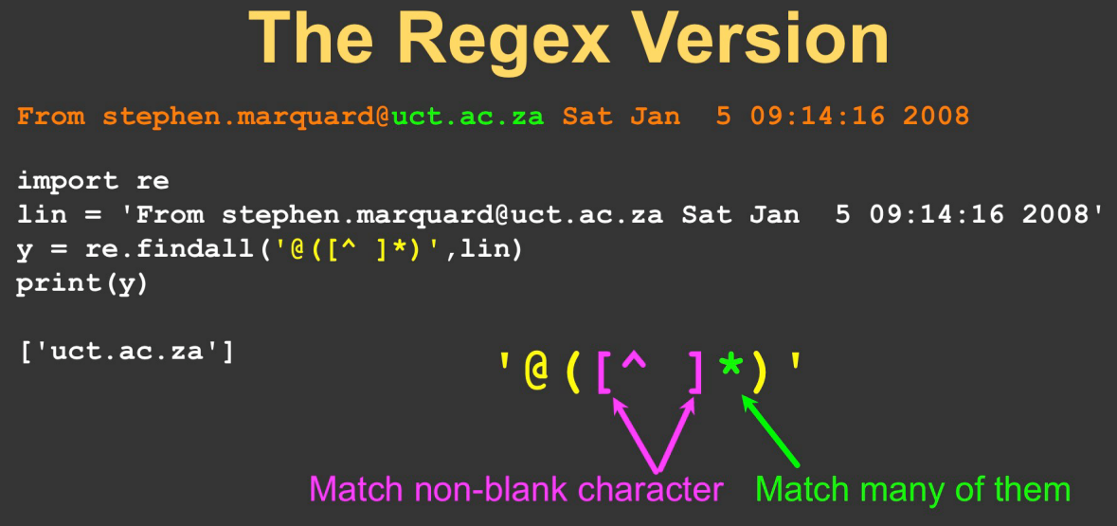

Slide 16
Multithreading and Multiprocessing

Slide 17
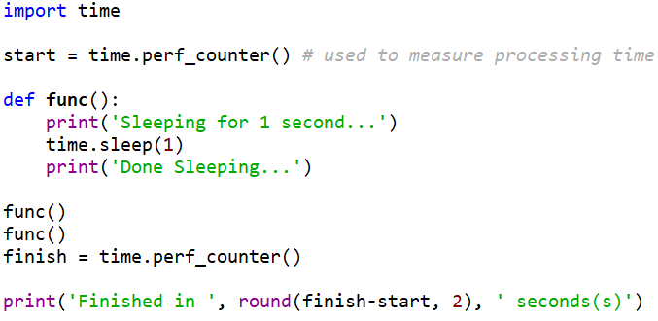
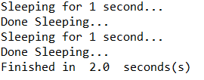
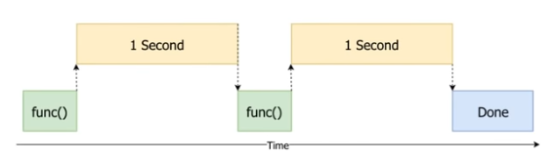
Multithreading and Multiprocessing
Used to speed up program performance
Tasks run concurrently
Normal processing is done synchronously
Example with no multithreading

Slide 18
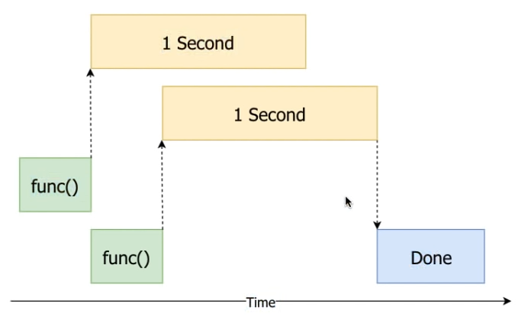
Multithreading
Processing divided into two tasks:
CPU bound – number crunching
IO bound – data transport
Mainly benefit when task is IO bound
Different ways to implement
Threads run concurrently
Example with multithreading

Slide 19
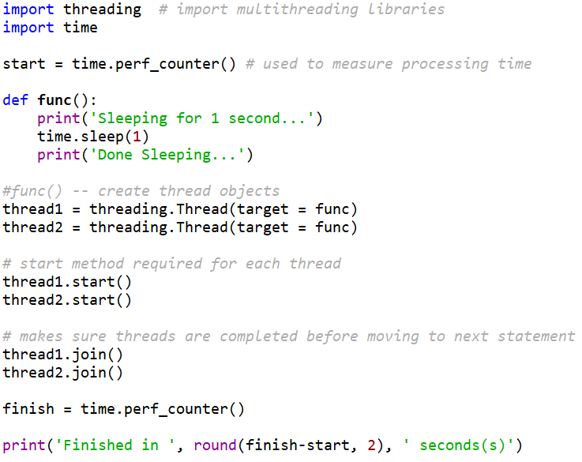
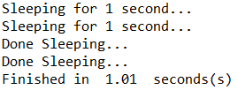
Multithreading

Slide 20
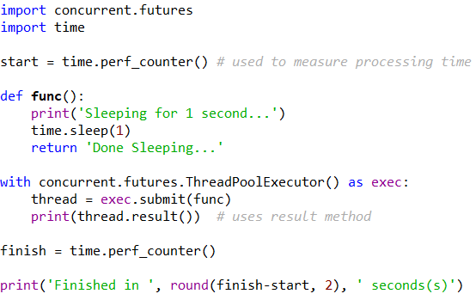
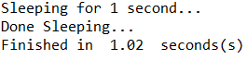
Multithreading
Concurrent class instead of threading
Uses context managers

Slide 21
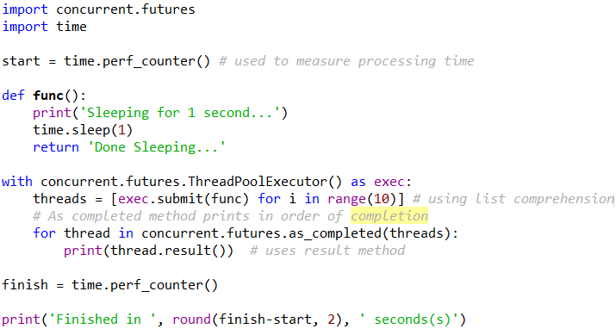
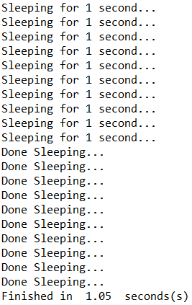
Multithreading
Running submit multiple times to run functions concurrently

Slide 22
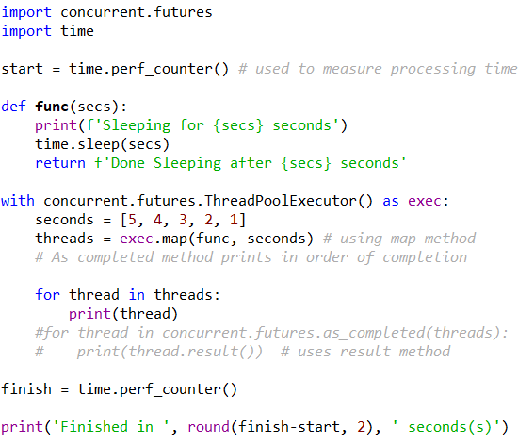
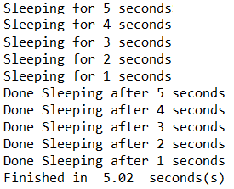
Multithreading
Running submit multiple times to run functions concurrently

Slide 23
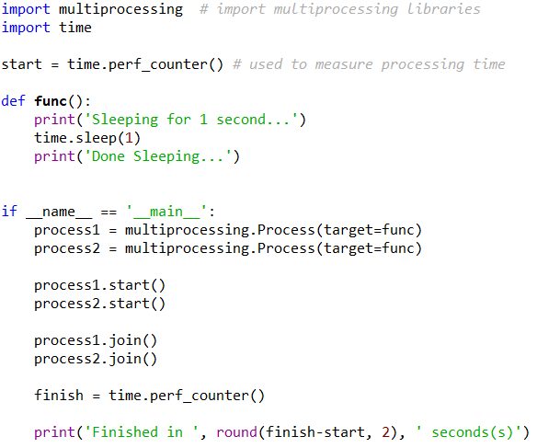
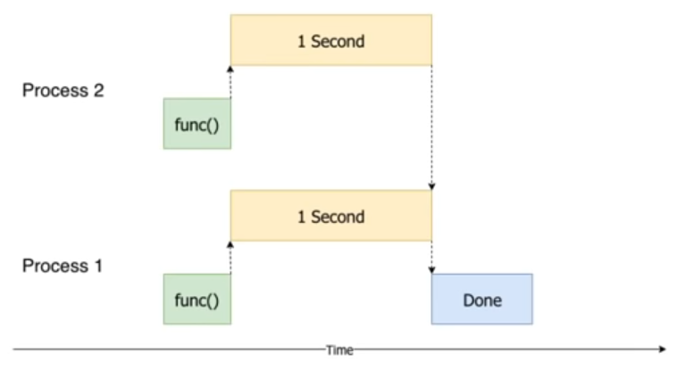
Multiprocessing
Mainly benefit when task is CPU bound
Spreads processing work onto separate processors

Slide 24
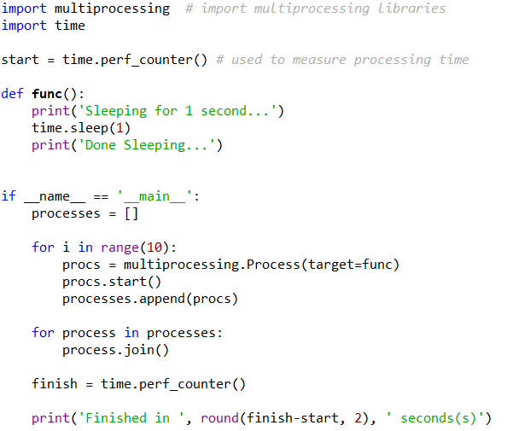
Multiprocessing
Running multiple processes in a for loop
Spreads processing work onto separate processors

Slide 25
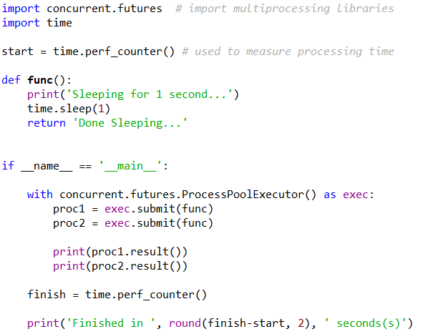
Multiprocessing
Multiprocessing using Concurrent library

Slide 26
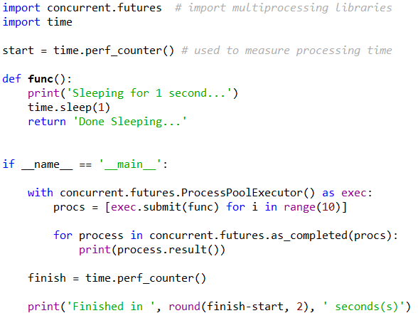
Multiprocessing
Multiprocessing using Concurrent library

Slide 27
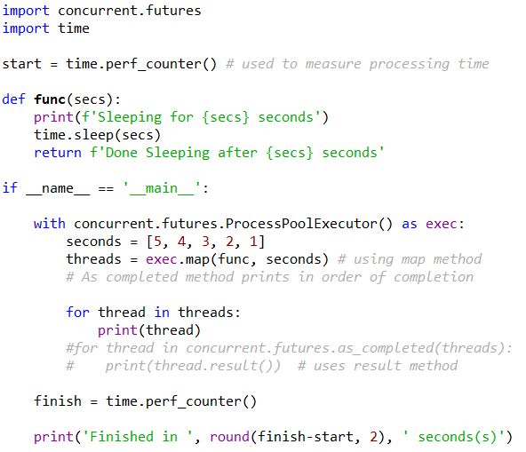
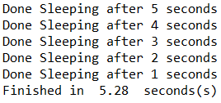
Multiprocessing
Multiprocessing using Concurrent library

Slide 28
Socket Programming in Python

Slide 29
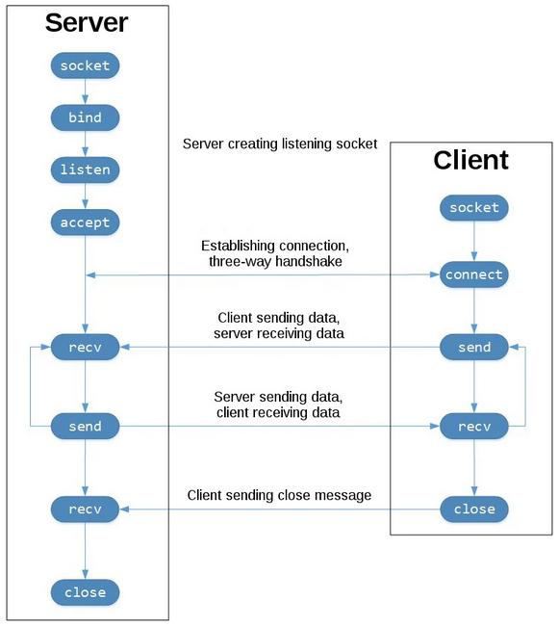
Socket API – Network Endpoint
socket()
bind()
listen()
accept()
connect()
connect_ex()
send()
recv()
close()
socket.socket() creates a socket object
socket.SOCK_STREAM is a transport control protocol (TCP) socket type
Bind is used to set the ipAddress and port
The listening socket listens for connections from clients
The client calls connect() to establish a connection to the server
Data is exchanged between the client and server using calls to send() and recv()
the client and server close() their respective sockets

Slide 30
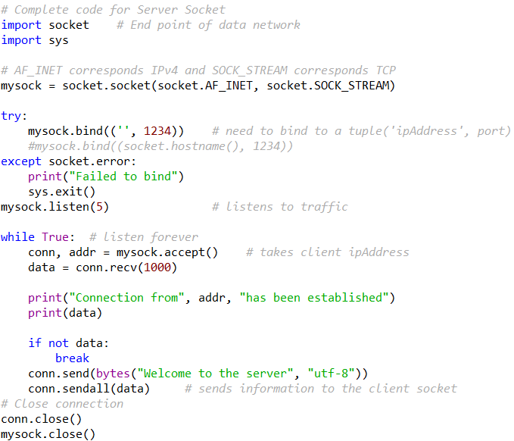
Server Socket

Slide 31
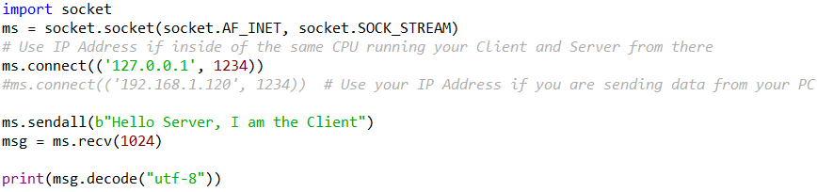
Client Socket

Slide 32
Server/ Client Socket Connection
Server Setup
Run the Server Socket before running the Client Socket
Open a command window and navigate to the directory where your Server_socket.py file is
Run the socket software by typing the following command in the command prompt, if you using Windows
>> py Server_socket.py
Otherwise use:
>> python3 Server_socket.py
Client Setup
Open a command window and navigate to the directory where your Client_socket.py file is
Run the socket software by typing the following command in the command prompt, if you using Windows
>> py Client_socket.py
Otherwise use:
>> python3 Client_socket.py

Slide 33
Pickling

Slide 34
Pickling
Process of converting an object hierarchy into a byte stream (serialization)
Reverse process is known as unpickling
Used for data storage and data transfer
Protocol specific to Python
Same version of Python is recommended
What can be Pickled?
Booleans
Integers
Floats
Complex numbers,
(normal and Unicode) Strings
Tuples
Lists
Sets
Dictionaries that contain picklable objects
Classes and functions defined at the top level of a module

Slide 35
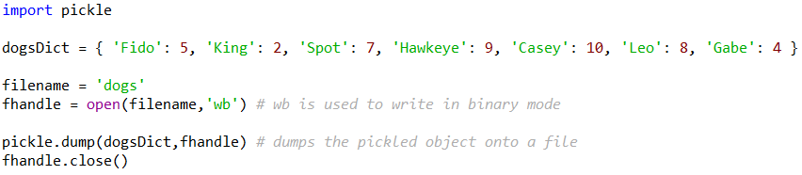
Pickling
What cannot be Pickled?
Generators
Inner Classes
Lambda Functions
Defaultdicts container datatype
Need to import pickle to use pickle libraries
Can also use dill package when working with multithreading
Creates an output file using pickle.dump( ) method

Slide 36
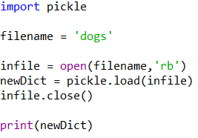
UnPickling
Reads in a file and recovers pickled content using pickle.load( ) method

Slide 37
Resources
Matt Huenerfauth (Penn State)
Guido van Rossum (Google)
Richard P. Muller (Caltech)
Bill Boyd (Weslayan University)
Smithsonian Telescope Data Center
Programming Python, Mark Lutz
Fundamentals of Python, Kenneth Lambert

